Slide 1
PREPARED BY :
LOAN STATUS PREDICTION
HARSHINI S

Slide 2
TABLE OF CONTENTS
Agenda
Data Description
Process followed in the project
Model 1, Model 2 and Model 3
Result

Slide 3
AGENDA
It is a classification problem , given information about the application we have to predict whether the they’ll be to pay the loan or not. The bank wants to automate the loan eligibility process (real time) based on customer detail provided while filling online application form. These details are Gender, Marital Status, Education, Number of Dependents, Income, Loan Amount, Credit History and others. To automate this process, they have given a problem to identify the customers segments, those are eligible for loan amount so that they can specifically target these customers.

Slide 4
DATA DESCRIPTION
Loan_ID
Gender
Married
Dependents
Education
Self_Employed
ApplicantIncome
CoapplicantIncome
LoanAmount
Loan_Amount_Term
Credit_History
Property_Area
Loan_Status

Slide 5
PROCESS FOLLOWED IN THE PROJECT
There are six process followed in the Project.
1st Process | 2nd Process | 3rd Process | 4th Process | 5th Process | 6th Process
Data Collection | Data Cleaning | Building Model | Training Model | Testing Model | Make Prediction
Collecting of the data | Pre-Processing of the data | Fitting into a model | Trains the particular data according to the model | Testing the particular data according to the model | Result

Slide 6
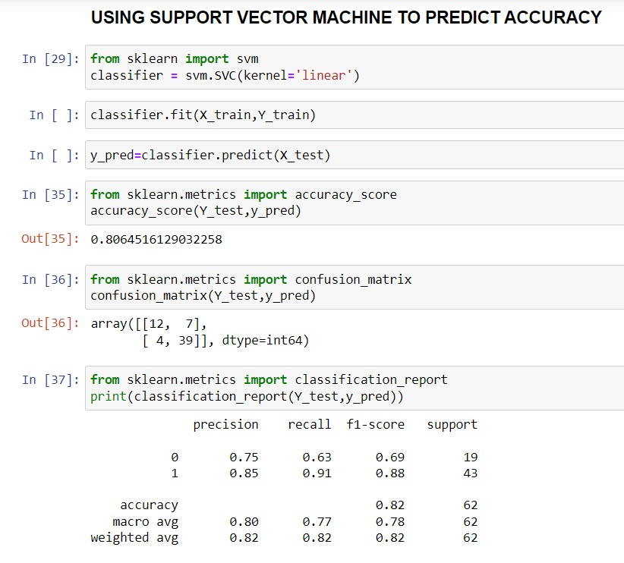
MODEL 1
Fitting the Support Vector Machine Classification method.
Training the data.
Testing the data.
By using the sklearn.metrics we predict the (Accuracy Score, Confusion Matrix, Classification Report)
The SVM Classification gives the Accuracy of 0.80

Slide 7
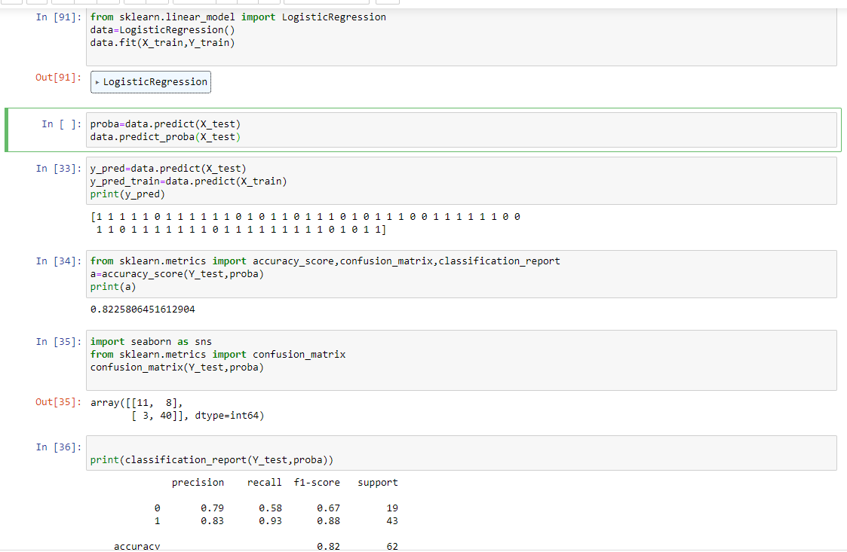
MODEL 2
Fitting the Logistic Regression Classification method.
Training the data.
Testing the data.
By using the sklearn.metrics we predict the (Accuracy Score, Confusion Matrix, Classification Report)
The Logistic Regression Classification gives the Accuracy of 0.82

Slide 8
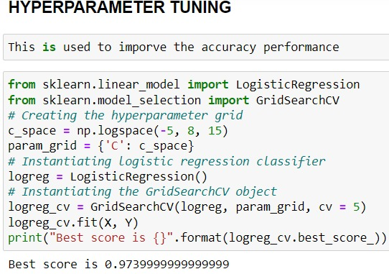
MODEL 3
Fitting the Hyperparameter tuning method.
Creating the hyperparameter grid.
Instantiating logistic regression classifier.
Instantiating the GridSearchCv object.
This hyperparameter tuning gives the Best score of 0.97 .
Displays the True and False Positive Rate.
Prediction for a model.

Slide 9
RESULT
FOR THIS PREDICTION I USED SVM AND LOGISTIC REGRESSION BY USING SVM IT GIVES ACCURACY OF 80% FOR LOGISTIC REGRESSION IT GIVES 82% SO I USED HYPER PARAMETER TUNING FOR LOGISTIC REGRESSION TO IMPROVE ACCURACY AND SET DATA TO BE FIT . IT GIVES A ACCURACY OF 97%.SO LOGISTIC REGRESSION IS THE BEST MODEL FOR ANALYSING
LOAN STATUS PREDICTION.

Slide 10
Any Questions & answers

Slide 11
THANK YOU

